Slide 1
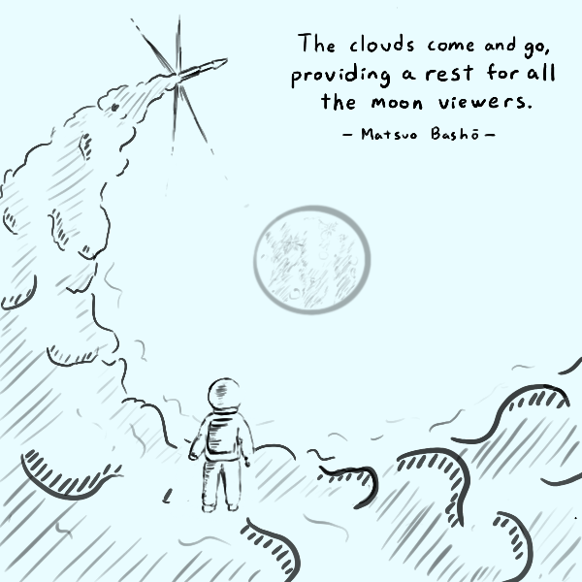
Announcements
Complete Homework 0 if you haven’t
Teaching feedback welcome

Slide 2
Last Time: Introduction and Security Principles
Course Logistics
Security Principles

Slide 3
Today’s Cunning Plan: Cryptography
Introduction to Cryptography
What is cryptography?
Definitions of key properties
IND-CPA security
A brief history of cryptography
Symmetric-key crypto
One-time pads

Slide 4
What is cryptography?

Slide 5
What is Cryptography?
Older definition: The study of secure communication over insecure channels
Newer definition: Provide rigorous guarantees on the security of data and computation in the presence of an attacker
Not just confidentiality but also integrity and authenticity (we’ll see these definitions today)
Modern cryptography is heavily based on math
The math is hard
We won’t cover the details. Wikipedia is a great resource
Some system / algorithms are provably secure

Slide 6
Definitions of Key Properties

Slide 7
Meet Alice, Bob, Eve, and Mallory
Alice and Bob: The main characters trying to send messages to each other over an insecure communication channel
Eve: An eavesdropper who can read any data sent over the channel
Mallory: A manipulator who can read and modify any data sent over the channel

Slide 8
Meet Alice, Bob, Eve, and Mallory
We often describe cryptographic problems using a common cast of characters
One scenario:
Alice wants to send a message to Bob.
However, Eve is going to eavesdrop on the communication channel.
How does Alice send the message to Bob without Eve learning about the message?
Another scenario:
Bob wants to send a message to Alice.
However, Mallory is going to tamper with the communication channel.
How does Bob send the message to Alice without Mallory changing the message?
Notes:
Passive attacker versus Active attacker

Slide 9
Three Goals of Cryptography
In cryptography, there are three main properties that we want on our information
Confidentiality: An adversary cannot read our messages.
Integrity: An adversary cannot change our messages without being detected.
Authenticity: I can prove that this message came from the person who claims to have written it.
Integrity and authenticity are closely related properties…
Before I can prove that a message came from a certain person, I have to prove that the message wasn’t changed!

Slide 10
Keys
The most basic building block of any cryptographic scheme: The key
We use the key in our algorithms to secure messages
Two models of keys:
Symmetric key model: Alice and Bob both know the value of the same secret key.
Example: One-time pad, AES encryption
Asymmetric key model: Everybody has two keys, a secret key and a public key.
Example: RSA encryption

Slide 11
Security Principle: Kerckhoff’s Principle
This principle is closely related to Shannon’s Maxim
Don’t use security through obscurity. Assume the attacker knows the system.
Kerckhoff’s principle says:
Cryptosystems should remain secure even when the attacker knows all internal details of the system
The key should be the only thing that must be kept secret
The system should be designed to make it easy to change keys that are leaked (or suspected to be leaked)
If your secrets are leaked, it is usually a lot easier to change the key than to replace every instance of the running software
Our assumption: The attacker knows all the algorithms we use. The only information the attacker is missing is the secret key(s).

Slide 12
Confidentiality
Confidentiality: An adversary cannot read our messages.
Analogy: Locking and unlocking the message
Alice uses the key to lock the message in a box
Alice sends the message (locked in the box) over the insecure channel
Eve sees the locked box, but cannot access the message without the key
Bob receives the message (locked in the box) and uses the key to unlock the message
Alice
Key
Insecure Channel
Key
Bob
Message
Lock
Message in locked box
Unlock
Message

Slide 13
Confidentiality
Schemes provide confidentiality by encrypting messages
Alice uses the key to encrypt the message: Change the message into a scrambled form
Alice sends the encrypted message over the insecure channel
Eve sees the encrypted message, but cannot figure out the original message without the key
Bob receives the encrypted message and uses the key to decrypt the message back into its original form
Alice
Key
Insecure Channel
Key
Bob
Message
Encryption Algorithm
Encrypted Message
Decryption Algorithm
Message

Slide 14
Confidentiality
Plaintext: The original message
Ciphertext: The encrypted message
Alice
Key
Insecure Channel
Key
Bob
Plaintext
Encryption Algorithm
Ciphertext
Decryption Algorithm
Plaintext

Slide 15
Integrity (and Authenticity)
Integrity: An adversary cannot change our messages without being detected.
Analogy: Adding a seal on the message
Alice uses the key to add a special seal on the message (e.g. puts tape on the envelope)
Alice sends the message and the seal over the insecure channel
If Mallory tampers with the message, she’ll break the seal (e.g. break the tape on the envelope)
Without the key, Mallory cannot create her own seal
Bob receives the message and the seal and checks that the seal has not been broken
Alice
Key
Insecure Channel
Key
Bob
Message
Create Seal
Message
Check Seal
Message
Seal

Slide 16
Integrity (and Authenticity)
Schemes provide integrity by adding a tag or signature on messages
Alice uses the key to generate a special tag for the message
Alice sends the message and the tag over the insecure channel
If Mallory tampers with the message, the tag will no longer be valid
Bob receives the message and the tag and checks that the tag is still valid
Alice
Key
Insecure Channel
Key
Bob
Message
Create Tag
Message
Check Tag
Message
Tag

Slide 17
Threat Models (Types of Cryptanalysis)
Ciphertext only
Attackers only have ciphertext, need to decrypt it
Known-plaintext
Attackers know some ciphertext and its corresponding plaintext, needs to decrypt some other cyphertext
Chosen-plaintext
Attackers can get any ciphertext they want encrypted, and need to decrypt some specific cyphertext
e.g., Eve can trick Alice into encrypting arbitrary messages of Eve's choice
In this class, we often use the chosen plaintext attack (CPA) model
Notes:
One thing I want to mention as we jump into this start on modern cryptography is types of crypt analysis and you may remember that crypt analysis is kind of the science of analyzing and trying to break cryptographic codes.
The first type of crypt analysis is called a ciphertext only attack in this case the attacker has some ciphertext and he needs to decrypt it and the ciphertext is the only thing he has now he may know the algorithm of course
because we mentioned before that the algorithm is not a secret so the attacker has some ciphertext and knows the algorithm that was used but doesn’t know the key if that's the case we call that a ciphertext on the attack because the only thing he has is the ciphertext now a more powerful type of attack would be a known plaintext attack this is where an attacker knows some ciphertext and its corresponding plaintext and wants to decrypt some other piece of ciphertext so we say well the attacker has some plaintext ciphertext pairs and some additional ciphertext that he wants to be able to decrypt the third type of cryptanalysis is a chosen plaintext attack now in a chosen plaintext attack an attacker can get any plaintext that he wants encrypted and he uses that to help him decrypt something else so you
think of it as okay the attacker can choose any plaintext he wants he can
have it encrypted and he can analyze that result in order to help him to to
decrypt some other ciphertext so these are the three types of cryptanalysis and we'll talk more about these as we go.

Slide 18
Three Types of Crypto

Slide 19
Three Common Types of Crypto
Secret Key Cryptography (Symmetric)
Public Key Cryptography (Asymmetric)
Hashing
Note that most crypto techniques have
An algorithm (What you do to the message)
A key (The secret that you need in order to encrypt / decrypt)
Notes:
We're only just going to do a brief overview of the three main types of cryptography that are used to build modern cryptographic systems.
The first type of crypto is secret key cryptography also sometimes called symmetric key cryptography.
The second is called public key cryptography sometimes called a symmetric key cryptography.
The third is called a message digest or sometimes called hashing so those are

Slide 20
Secret-Key (Symmetric) Crypto
Both parties share the same key in the communication
The same key is used for encryption and decryption
Alice
Key
Insecure Channel
Key
Bob
Plaintext
Encryption Algorithm
Ciphertext
Decryption Algorithm
Plaintext
Notes:
Let’s look at the first cryptographic technique here which is secret key or
symmetric key crypto.
This is a cryptographic technique where both people in the in the communications share the same key in fact this is what you would normally think of when you think of you knows encrypting a message.
In this case Alice has her secret message she wants to send and she has her algorithm that she wants to use.
In this case the secret key algorithm and she has her key.
She puts the key and the message into the algorithm and what she gets out is a cipher text, her coded message.
She sends the coded message to Bob.
Bob takes the coded message and combines it into the algorithm with the
Key when he gets out his the original plaintext message that Alice encoded.
So in this case Alice and Bob are both using the same key. Alice encrypts with that key and Bob decrypt with that same key.
The symmetric key or secret key cryptography is a cryptographic technique where both parties in the communication share the same key.
In the example we mentioned previously, we have Alice taking her plain text and encrypting it with a secret key to get her ciphertext.
Bob takes that same ciphertext and he decrypts it with the same secret key.
So those two keys are the same and he gets out the original plaintext that Alice encrypted.
So that's basically how symmetric key cryptography works.

Slide 21
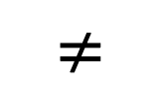
Public-Key (Asymmetric) Crypto
Both parties use different key in the communication
Everyone has two keys: a private key and a public key
The two keys are mathematically related, it’s almost impossible to get private key from public key
Public key for encryption
Private key for decryption
Alice
Bob’s Public Key
Insecure Channel
$$≠$$
Bob
Bob’s Private Key
Bob’s Public Key
Plaintext
Encryption Algorithm
Ciphertext
Decryption Algorithm
Plaintext
Notes:
The second common cryptography is called public key or asymmetric key cryptography.
This is a cryptographic technique where both parties in the communication used different keys let me show you what I mean. Let's pretend that Bob has two keys: the first is his private key it’s a secret that only he knows and the second is a public key which is something that he which is a key that he's willing to give to anybody in the world now those two keys are mathematically related in such a way that if you encrypt with one you should decrypt with the other.
Let's look at an example here so in this case Alice takes her secret message that she wants to send Bob and she has an asymmetric cryptographic algorithm and she has Bob's public key now she uses the key
with her message and she produces the ciphertext she sends that ciphertext to Bob and in this case Bob's going to decrypt it using his private key in
order to get back the original message so this is.
It's important to note here that Alice encrypted with one key and Bob decrypted with another key and those two keys are not the same they're not equal so that's what we call asymmetric cryptography you know symmetric means two things that are the same on both
Sides asymmetric is things that are different on both sides so in this case it's
asymmetric because you use a different key for encryption than you do for decryption.

Slide 22
Hashing
Transform any arbitrary message into a fixed length number
Should be one-way
Message -> Hash is easy
Hash -> Message is hard
Widely used in other fields
Notes:
The third common crypto technique is hashing. In hashing, we transform any arbitrary message into a fixed length number and the hash function should be one-way so that means that if we have that we can take a
message and we can easily generate its hash.
But if we have a hash it's really really hard to find a message with that hash so hashing is actually widely used in a lot of areas of computing not just within security or cryptography. and so it's a good thing to know

Slide 23
Cryptography Roadmap
 | Symmetric-key | Asymmetric-key
Confidentiality | One-time pads Block ciphers with chaining modes (e.g. AES-CBC) Stream ciphers | RSA encryption ElGamal encryption
Integrity, Authentication | MACs (e.g. HMAC) | Digital signatures (e.g. RSA signatures)
Hash functions
Pseudorandom number generators
Public key exchange (e.g. Diffie-Hellman)
Key management (certificates)
Password management

Slide 24
Symmetric-Key Encryption

Slide 25
Cryptography Roadmap
 | Symmetric-key | Asymmetric-key
Confidentiality | One-time pads Block ciphers with chaining modes (e.g. AES-CBC) Stream ciphers | RSA encryption ElGamal encryption
Integrity, Authentication | MACs (e.g. HMAC) | Digital signatures (e.g. RSA signatures)
Hash functions
Pseudorandom number generators
Public key exchange (e.g. Diffie-Hellman)
Key management (certificates)
Password management

Slide 26
Symmetric-Key Encryption
The next few schemes are symmetric-key encryption schemes
Encryption schemes aim to provide confidentiality (but not integrity or authentication)
Symmetric-key means Alice and Bob share the same secret key that the attacker doesn’t know
Don’t worry about how Alice and Bob share the key for now
For modern schemes, we’re going to assume that messages are bitstrings
Bitstring: A sequence of bits (0 or 1), e.g. 11010101001001010
Text, images, etc. can usually be converted into bitstrings before encryption, so bitstrings are a useful abstraction. After all, everything in a computer is just a sequence of bits!

Slide 27
Symmetric-Key Encryption: Definition
A symmetric-key encryption scheme has three algorithms:
KeyGen() → K: Generate a key K
Enc(K, M) → C: Encrypt a plaintext M using the key K to produce ciphertext C
Dec(K, C) → M: Decrypt a ciphertext C using the key K
Alice
Key
Insecure Channel
Key
Bob
Plaintext
Encryption Algorithm
Ciphertext
Decryption Algorithm
Plaintext

Slide 28
Symmetric-Key Encryption: Definition
What properties do we want from a symmetric encryption scheme?
Correctness: Decrypting a ciphertext should result in the message that was originally encrypted
Dec(K, Enc(K, M)) = M for all K ← KeyGen() and M
Efficiency: Encryption/decryption algorithms should be fast: >1 Gbps on a standard computer
Security: Confidentiality
Alice
Key
Insecure Channel
Key
Bob
Plaintext
Encryption Algorithm
Ciphertext
Decryption Algorithm
Plaintext

Slide 29
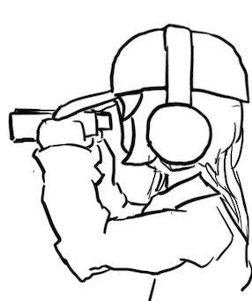
Defining Confidentiality
Recall our definition of confidentiality from earlier: “An adversary cannot read our messages”
This definition isn’t very specific
What if Eve can read the first half of Alice’s message, but not the second half?
What if Eve figures out that Alice’s message starts with “Dear Bob”?
This definition doesn’t account for prior knowledge
What if Eve already knew that Alice’s message ends in “Sincerely, Alice”?
What if Eve knows that Alice’s message is “BUY!” or “SELL” but doesn't know which?

Slide 30
Defining Confidentiality
A better definition of confidentiality: The ciphertext should not give the attacker any additional information about the plaintext.
Let's design an experiment/security game to test our definition:
Eve chooses two messages M0 and M1 of the same length
Alice chooses one message at random Mb, encrypts it, and sends the ciphertext
Eve knows either M0 or M1 was sent, but doesn't know which
Eve reads the ciphertext and tries to guess which message was sent
If the probability that Eve correctly guesses which message was sent is 1/2, then the encryption scheme is confidential
Intuition
If the scheme is confidential, Eve can only guess with probability 1/2, which is no different than if Eve hadn’t sent the ciphertext at all
In other words: the ciphertext gave Eve no additional information about which plaintext was sent!
Notes:
Shafi and Silvio won 2012 Turing award for probabilistic encryption, proving the need for randomization, laying foundations for modern cryptography and much stronger guarantees

Slide 31
Defining Confidentiality: IND-CPA
Recall our threat model: Eve can also perform a chosen plaintext attack (CPA)
It means, Eve can trick Alice into encrypting arbitrary messages of Eve's choice
We can adapt our experiment to account for this threat model
A better definition of confidentiality: Even if Eve is able to trick Alice into encrypting messages, Eve can still only guess what message Alice sent with probability 1/2.
This definition is called IND-CPA (indistinguishability under chosen plaintext attack)
Cryptographic properties are often defined in terms of “games” that an adversary can either “win” or “lose”

Slide 32
Defining Confidentiality: IND-CPA
Eve (adversary)
Alice (challenger)
Eve may choose plaintexts to send to Alice and receives their ciphertexts
M
(repeat)
Enc(K, M)

Slide 33
Defining Confidentiality: IND-CPA
Eve (adversary)
Alice (challenger)
Eve may choose plaintexts to send to Alice and receives their ciphertexts
Eve issues a pair of plaintexts M0 and M1 to Alice
M
(repeat)
Enc(K, M)
M0 and M1

Slide 34
Defining Confidentiality: IND-CPA
Eve (adversary)
Alice (challenger)
Eve may choose plaintexts to send to Alice and receives their ciphertexts
Eve issues a pair of plaintexts M0 and M1 to Alice
Alice randomly chooses either M0 or M1 to encrypt and sends the encryption back
Alice does not tell Eve which one was encrypted!
M
(repeat)
Enc(K, M)
M0 and M1
pick b
Enc(K, Mb)

Slide 35
Defining Confidentiality: IND-CPA
Eve (adversary)
Alice (challenger)
Eve may choose plaintexts to send to Alice and receives their ciphertexts
Eve issues a pair of plaintexts M0 and M1 to Alice
Alice randomly chooses either M0 or M1 to encrypt and sends the encryption back
Alice does not tell Eve which one was encrypted!
Eve may again choose plaintexts to send to Alice and receives their ciphertexts
M
(repeat)
Enc(K, M)
M0 and M1
pick b
Enc(K, Mb)
M
(repeat)
Enc(K, M)

Slide 36
Defining Confidentiality: IND-CPA
Eve (adversary)
Alice (challenger)
Eve may choose plaintexts to send to Alice and receives their ciphertexts
Eve issues a pair of plaintexts M0 and M1 to Alice
Alice randomly chooses either M0 or M1 to encrypt and sends the encryption back
Alice does not tell Eve which one was encrypted!
Eve may again choose plaintexts to send to Alice and receives their ciphertexts
Eventually, Eve outputs a guess as to whether Alice encrypted M0 or M1
M
(repeat)
Enc(K, M)
M0 and M1
pick b
Enc(K, Mb)
M
(repeat)
Enc(K, M)
Guess b = 0 or b = 1

Slide 37
Defining Confidentiality: IND-CPA
If Eve correctly guesses which message Alice encrypted, then Eve wins. Otherwise, she loses.
How does Eve guess whether M0 or M1 was encrypted? What strategy does she use?
We don’t assume she uses a particular strategy; Eve represents all possible strategies
Proving insecurity: There exists at least one strategy that can win the IND-CPA game with probability > 1/2
1/2 is the probability of winning by random guessing
If you can be better than random, then the ciphertext has leaked information, and Eve is able to learn it and use it to gain an advantage!
Proving security: For all attackers/Eve-s, the probability of winning the IND-CPA game is at most 1/2
Notes:
Ask: What if there is an adversary that can win with probability 0.4?

Slide 38
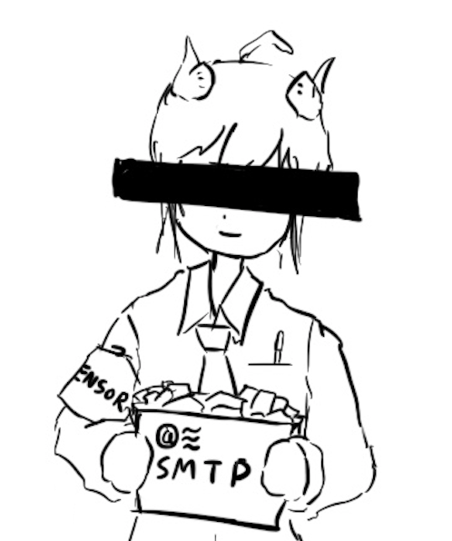
Edge Cases: Length
Cryptographic schemes are (usually) allowed to leak the length of the message
To hide length: All messages must always be the same length
16-byte messages: We can’t encrypt large messages (images, videos, etc.)!
1-GB messages: Sending small messages (text, Tweets, etc.) needs 1 GB of bandwidth!
This is unpractical
In the IND-CPA game: M0 and M1 must be the same length
To break IND-CPA, Eve must learn something other than message length

Slide 39
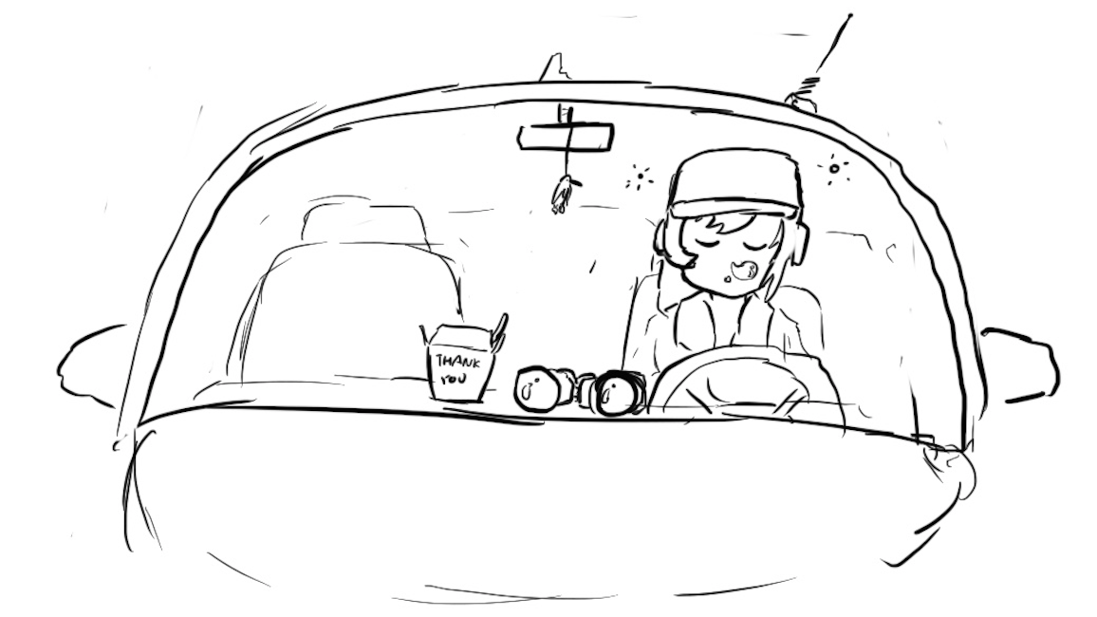
Edge Cases: Attacker Runtime
Some schemes are theoretically vulnerable, but secure in any real-world setting
If an attack takes longer than the life of the solar system to complete, it probably won’t happen!
Or if it would require a computer made out of a literal galaxy worth of science-fiction nanotech
In the IND-CPA game: Eve is limited to a practical runtime
One common practical limit: Eve is limited to polynomial runtime algorithms (no exponential-time algorithms)

Slide 40

Edge Cases: Negligible Advantage
Sometimes it’s possible for Eve to win with probability 1/2 + 1/2¹²⁸
This probability is greater than 1/2, but it's so close to 1/2 that it's as good as 1/2.
Eve's advantage is so small that she can't use it for any practical attacks
In the IND-CPA game: The scheme is secure even if Eve can win with probability ≤ 1/2 + Ɛ, where Ɛ is negligible
The actual mathematical definition of negligible is out of scope
Example: 1/2 + 1/2¹²⁸: Negligible advantage
Example: 2/3: Non-negligible advantage

Slide 41

IND-CPA: Putting it together
Eve (adversary)
Alice (challenger)
Eve may choose plaintexts to send to Alice and receives their ciphertexts
Eve issues a pair of plaintexts M0 and M1 to Alice
Alice randomly chooses either M0 or M1 to encrypt and sends the encryption back
Alice does not tell Eve which one was encrypted!
Eve may again choose plaintexts to send to Alice and receives their ciphertexts
Eventually, Eve outputs a guess as to whether Alice encrypted M0 or M1
An encryption scheme is IND-CPA secure if for all polynomial time attackers Eve:
Eve can win with probability ≤ 1/2 + Ɛ, where Ɛ is negligible.
M
(repeat)
Enc(K, M)
M0 and M1
pick b
Enc(K, Mb)
M
(repeat)
Enc(K, M)
Guess b = 0 or b = 1
Notes:
Let’s stop to chew on this.
For most cases, ½ (one half) is the main thing to worry about.

Slide 42
A Brief History of Cryptography

Slide 43
Cryptography by Hand: Caesar Cipher
One of the earliest cryptographic schemes was the Caesar cipher
Used by Julius Caesar over 2,000 years ago
KeyGen():
Choose a key K randomly between 0 and 25
Enc(K, M):
Replace each letter in M with the letter K positions later in the alphabet
If K = 3, plaintext DOG becomes GRJ
Dec(K, C):
Replace each letter in C with the letter K positions earlier in the alphabet
If K = 3, ciphertext GRJ becomes DOG
K = 3
M | C | M | C
A | D | N | Q
B | E | O | R
C | F | P | S
D | G | Q | T
E | H | R | U
F | I | S | V
G | J | T | W
H | K | U | X
I | L | V | Y
J | M | W | Z
K | N | X | A
L | O | Y | B
M | P | Z | C

Slide 44
Cryptography by Hand: Attacks on the Caesar Cipher
Eve sees the ciphertext JCKN ECGUCT, but doesn’t know the key K
If you were Eve, how would you try to break this algorithm?
Brute-force attack: Try all 26 possible keys!
Use existing knowledge: Assume that the message is in English
+1 IBJM DBFTBS
+2 HAIL CAESAR
+3 GZHK BZDRZQ
+4 FYGJ AYCQYP
+5 EXFI ZXBPXO
+6 DWEH YWAOWN
+7 CVDG XVZNVM
+8 BUCF WUYMUL
+9 ATBE VTXLTK
+10 ZSAD USWKSJ
+11 YRZC TRVJRI
+12 XQYB SQUIQH
+13 WPXA RPTHPG
+14 VOWZ QOSGOF
+15 UNVY PNRFNE
+16 TMUX OMQEMD
+17 SLTW NLPDLC
+18 RKSV MKOCKB
+19 QJRU LJNBJA
+20 PIQT KIMAIZ
+21 OHPS JHLZHY
+22 NGOR IGKYGX
+23 MFNQ HFJXFW
+24 LEMP GEIWEV
+25 KDLO FDHVDU

Slide 45
Cryptography by Hand: Attacks on the Caesar Cipher
Eve sees the ciphertext JCKN ECGUCT, but doesn’t know the key K
Chosen-plaintext attack: Eve tricks Alice into encrypting plaintext of her choice
Eve sends a message M = AAA and receives C = CCC
Eve can deduce the key: C is 2 letters after A, so K = 2
Eve has the key, so she can decrypt the ciphertext

Slide 46
Cryptography by Hand: Substitution Cipher
A better cipher: create a mapping of each character to another character.
Example: A = N, B = Q, C = L, D = Z, etc.
Unlike the Caesar cipher, the shift is no longer constant!
KeyGen():
Generate a random, one-to-one mapping of characters
Enc(K, M):
Map each letter in M to the output according to the mapping K
Dec(K, C):
Map each letter in C to the output according to the reverse of the mapping K
K
M | C | M | C
A | N | N | G
B | Q | O | P
C | L | P | T
D | Z | Q | A
E | K | R | J
F | R | S | O
G | V | T | D
H | U | U | I
I | E | V | C
J | S | W | F
K | B | X | M
L | W | Y | X
M | Y | Z | H

Slide 47
Cryptography by Hand: Attacks on Substitution Ciphers
Does the brute-force attack still work?
There are 26! ≈ 2⁸⁸ possible mappings to try
Too much for most modern computers… for now
How about the chosen-plaintext attack?
Trick Alice into encrypting ABCDEFGHIJKLMNOPQRSTUVWXYZ, and you’ll get the whole mapping!
Another strategy: cryptanalysis
The most common English letters in text are E, T, A, O, I, N
K
M | C | M | C
A | N | N | G
B | Q | O | P
C | L | P | T
D | Z | Q | A
E | K | R | J
F | R | S | O
G | V | T | D
H | U | U | I
I | E | V | C
J | S | W | F
K | B | X | M
L | W | Y | X
M | Y | Z | H

Slide 48
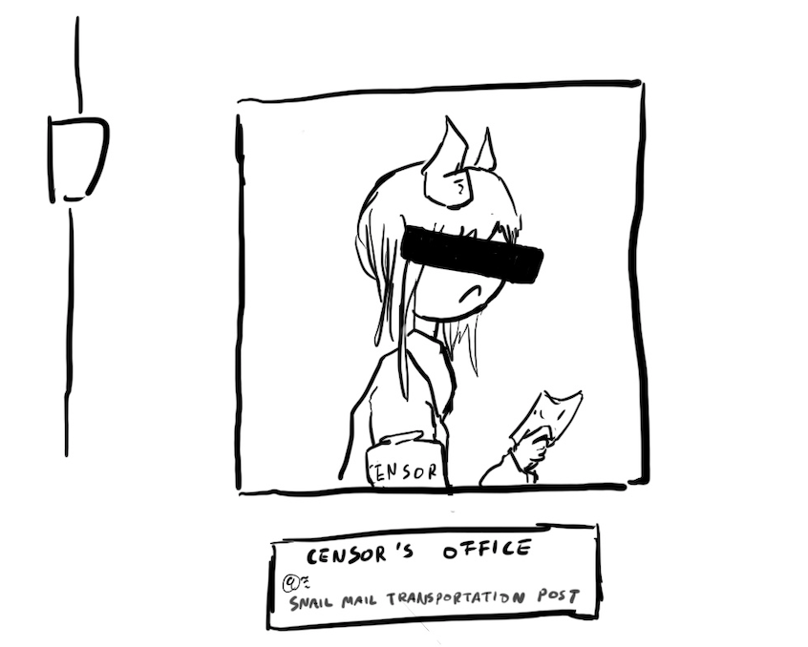
Takeaways
Cryptography started with paper-and-pencil algorithms (Caesar cipher)
Then cryptography moved to machines (Enigma)
Finally, cryptography moved to computers (which we’re about to study)
Hopefully you gained some intuition for some of the cryptographic definitions

Slide 49
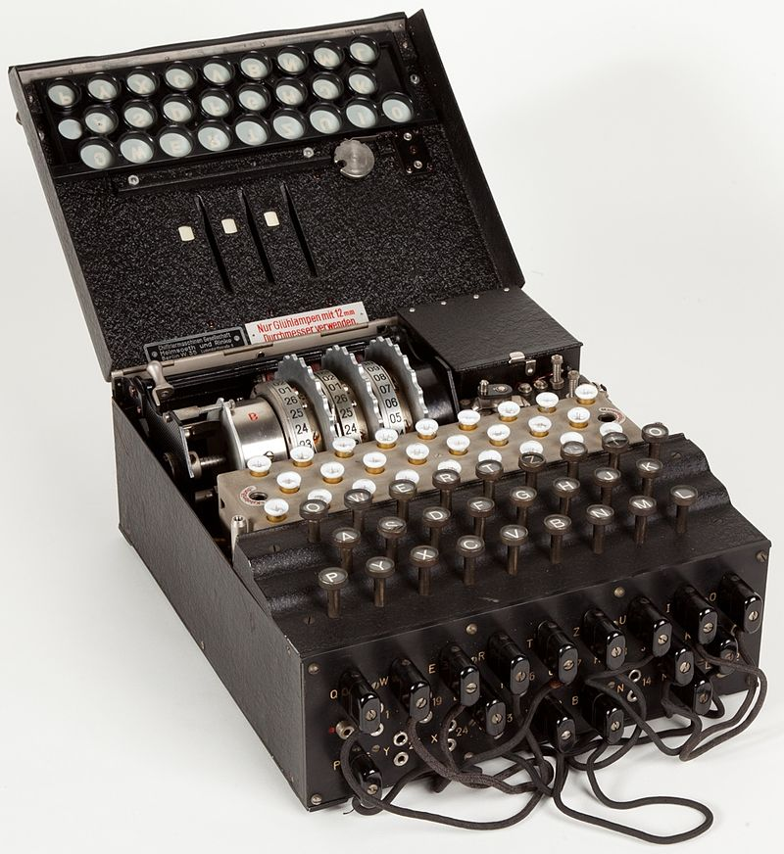

Cryptography by Machines: Enigma
A mechanical encryption machine used by the Germans in WWII
Rotors
Plugboard

Slide 50
Enigma Operating Principle: Rotor Machine
The encryption core was composed of 3 or 4 rotors
Each rotor was a fixed permutation (e.g. A maps to F, B maps to Q...)
And the end was a "reflector", a rotor that sent things backwards
Plus a fixed-permutation plugboard
A series of rotors were arranged in a sequence
Each keypress would generate a current from the input to one light for the output
Each keypress also advanced the first rotor
When the first rotor makes a full rotation, the second rotor advances one step
When the second rotor makes a full rotation, the third rotor advances once step

Slide 51
Cryptography by Machines: Enigma
KeyGen():
Choose rotors, rotor orders, rotor positions, and plugboard settings
158,962,555,217,826,360,000 possible keys
Enc(K, M) and Dec(K, C):
Input the rotor settings K into the Enigma machine
Press each letter in the input, and the lampboard will light up the corresponding output letter
Encryption and decryption are the same algorithm!
Germans believed that Enigma was an “unbreakable code”

Slide 52
Cryptography by Machines: Enigma
Eve (adversary)
Alice (challenger)
Enigma has a significant weakness: a letter never maps to itself!
No rotor maps a letter to itself
The reflector never maps a letter to itself
This property is necessary for Enigma’s mechanical system to work
What pair of messages should Eve send to Alice in the challenge phase?
Send M0 = A^{k}, M1 = B^{k}
M0 is a string of k 'A' characters, M1 is a string of k 'B' characters
How can Eve probably know which message Alice encrypted?
If there are no 'A' characters, it was M0
If there are no 'B' characters, it was M1
M
(repeat)
Enc(K, M)
M0 and M1
pick b
Enc(K, Mb)
M
(repeat)
Enc(K, M)
Guess b = 0 or b = 1

Slide 53
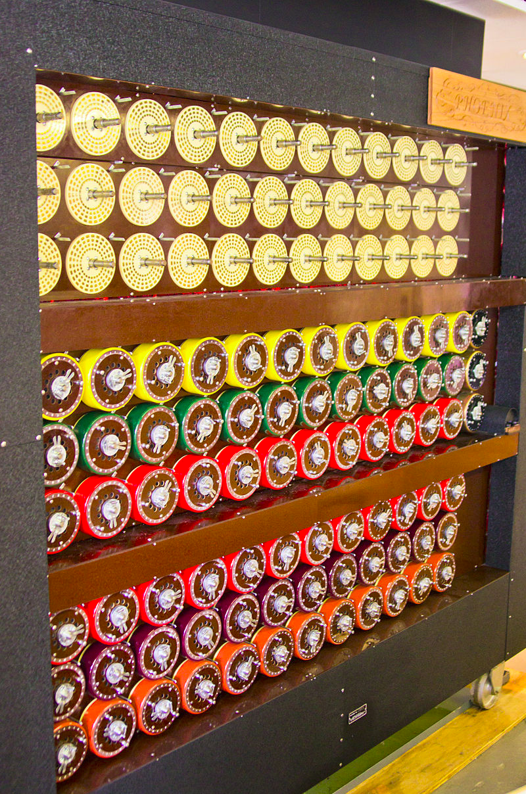
Cryptography by Machines: Attack on Enigma
Polish and British cryptographers built BOMBE, a machine to brute-force Enigma keys
Why was Enigma breakable?
Kerckhoff’s principle: The Allies stole Enigma machines, so they knew the algorithm
Known plaintext attacks: the Germans often sent predictable messages (e.g. the weather report every morning)
Chosen plaintext attacks: the Allies could trick the Germans into sending a message (e.g. “newly deployed minefield”)
Brute-force: BOMBE would try many keys until the correct one was found
Plus a weakness: You'd be able to try multiple keys with the same hardware configuration
BOMBE machine

Slide 54

Cryptography by Machines: Legacy of Enigma
Alan Turing, one of the cryptographers who broke Enigma, would go on to become one of the founding fathers of computer science
Most experts agree that the Allies breaking Enigma shortened the war in Europe by about a year
Alan Turing
Notes:
2014 movie, the imitation game, which is a move about Alan Turing.

Slide 55


Cryptography by Computers
The modern era of cryptography started after WWII, with the work of Claude Shannon
“New Directions in Cryptography” (1976) showed how number theory can be used in cryptography
Its authors, Whitfield Diffie and Martin Hellman, won the Turing Award in 2015 for this paper
This is the era of cryptography we’ll be focusing on
One of these is Diffie, and the other one is Hellman.

Slide 56
One-Time Pads

Slide 57
Cryptography Roadmap
 | Symmetric-key | Asymmetric-key
Confidentiality | One-time pads Block ciphers Stream ciphers | RSA encryption
Integrity, Authentication | MACs | Digital signatures
Hash functions
Pseudorandom number generators
Public key exchange (e.g. Diffie-Hellman)
Key management (certificates)
Password management

Slide 58
Review: XOR
The XOR operator takes two bits and outputs one bit:
Useful properties of XOR:
0 ⊕ 0 = 0
0 ⊕ 1 = 1
1 ⊕ 0 = 1
1 ⊕ 1 = 0
x ⊕ 0 = x
x ⊕ x = 0
x ⊕ y = y ⊕ x
(x ⊕ y) ⊕ z = x ⊕ (y ⊕ z)
(x ⊕ y) ⊕ x = y

Slide 59
Review: XOR Algebra
Algebra works on XOR too
y ⊕ 1 = 0 | Goal: Solve for y
y ⊕ 1 ⊕ 1 = 0 ⊕ 1 | XOR both sides by 1
y = 1 | Simplify with identities

Slide 60
One-Time Pads: Key Generation
Alice
K
0 | 1 | 1 | 0 | 0 | 1 | 0 | 1 | 0 | 1 | 1 | 1
The key K is a randomly-chosen bitstring.
Recall: We are in the symmetric-key setting, so we’ll assume Alice and Bob both know this key.

Slide 61
One-Time Pads: Encryption
Alice
K
0 | 1 | 1 | 0 | 0 | 1 | 0 | 1 | 0 | 1 | 1 | 1
M
1 | 0 | 0 | 1 | 1 | 0 | 0 | 1 | 0 | 1 | 0 | 0
The plaintext M is the bitstring that Alice wants to encrypt.
Idea: Use XOR to scramble up M with the bits of K.

Slide 62
One-Time Pads: Encryption
Alice
K
0 | 1 | 1 | 0 | 0 | 1 | 0 | 1 | 0 | 1 | 1 | 1
⊕ | ⊕ | ⊕ | ⊕ | ⊕ | ⊕ | ⊕ | ⊕ | ⊕ | ⊕ | ⊕ | ⊕
M
1 | 0 | 0 | 1 | 1 | 0 | 0 | 1 | 0 | 1 | 0 | 0
↓ | ↓ | ↓ | ↓ | ↓ | ↓ | ↓ | ↓ | ↓ | ↓ | ↓ | ↓
C
1 | 1 | 1 | 1 | 1 | 1 | 0 | 0 | 0 | 0 | 1 | 1
Encryption algorithm: XOR each bit of K with the matching bit in M.
The ciphertext C is the encrypted bitstring that Alice sends to Bob over the insecure channel.

Slide 63
One-Time Pads: Decryption
Bob
K
0 | 1 | 1 | 0 | 0 | 1 | 0 | 1 | 0 | 1 | 1 | 1
C
1 | 1 | 1 | 1 | 1 | 1 | 0 | 0 | 0 | 0 | 1 | 1
Bob receives the ciphertext C. Bob knows the key K. How does Bob recover M?

Slide 64
One-Time Pads: Decryption
Bob
K
0 | 1 | 1 | 0 | 0 | 1 | 0 | 1 | 0 | 1 | 1 | 1
⊕ | ⊕ | ⊕ | ⊕ | ⊕ | ⊕ | ⊕ | ⊕ | ⊕ | ⊕ | ⊕ | ⊕
C
1 | 1 | 1 | 1 | 1 | 1 | 0 | 0 | 0 | 0 | 1 | 1
↓ | ↓ | ↓ | ↓ | ↓ | ↓ | ↓ | ↓ | ↓ | ↓ | ↓ | ↓
M
1 | 0 | 0 | 1 | 1 | 0 | 0 | 1 | 0 | 1 | 0 | 0
Decryption algorithm: XOR each bit of K with the matching bit in C.

Slide 65
One-Time Pad
KeyGen()
Randomly generate an n-bit key, where n is the length of your message
Recall: For today, we assume that Alice and Bob can securely share this key
For one-time pads, we generate a new key for every message
Enc(K, M) = K ⊕ M
Bitwise XOR M and K to produce C
In other words: XOR the ith bit of the plaintext with the ith bit of the key.
Ci = Ki ⊕ Mi
Alice and Bob use a different key for each encryption (this is the “one-time” in one-time pad).
Dec(K, C) = K ⊕ C
Bitwise XOR C and K to produce M
Mi = Ki ⊕ Ci
Notes:
Ask students if they can produce the decryption equation before showing it to them

Slide 66
One-Time Pad: Correctness
Correctness: If we encrypt and then decrypt, we should get the original message back
Enc(K, M) | = | K ⊕ M | Definition of encryption
Dec(K, Enc(K, M)) | = | Dec(K, K ⊕ M) | Decrypting the ciphertext
 | = | K ⊕ (K ⊕ M) | Definition of decryption
 | = | M | XOR property

Slide 67
One-Time Pad: Security
Recall our definition of confidentiality: The ciphertext should not give the attacker any additional information about the plaintext
Recall our experiment to test confidentiality from earlier:
Alice has encrypted and sent either M0 or M1
Eve knows either M0 or M1 was sent, but doesn't know which
Eve reads the ciphertext and tries to guess which message was sent
If the probability that Eve correctly guesses which message was sent is 1/2, then the encryption scheme is confidential

Slide 68
One-Time Pad: Security
Possibility 0: Alice sends Enc(K, M0)
Possibility 1: Alice sends Enc(K, M1)
The ciphertext is C = K ⊕ M0
Therefore, K = C ⊕ M0
The ciphertext is C = K ⊕ M1
Therefore, K = C ⊕ M1
K was chosen randomly, so both possibilities are equally possible
Eve has learned no new information, so the scheme is perfectly secure

Slide 69
Impracticality of One-Time Pads
Problem #1: Key generation
For security to hold, keys must be randomly generated for every message, and never reused
Randomness is expensive, as we’ll see later
Problem #2: Key distribution
To communicate an n-bit message, we need to securely communicate an n-bit key first
But if we have a way to securely communicate an n-bit key, we could have communicated the message directly!
Only practical application: Communicate keys in advance
You have a secure channel now, but you won’t have it later
Use the secure channel now to communicate keys in advance
Use one-time pad later to communicate over the insecure channel
And people can compute this by hand without computers!

Slide 70
Summary
What is cryptography?
Definitions of key properties
A better definition of confidentiality: IND-CPA security
A brief history of cryptography
Symmetric-key crypto

